Slide 1
Filtering with the Data Table

Slide 2
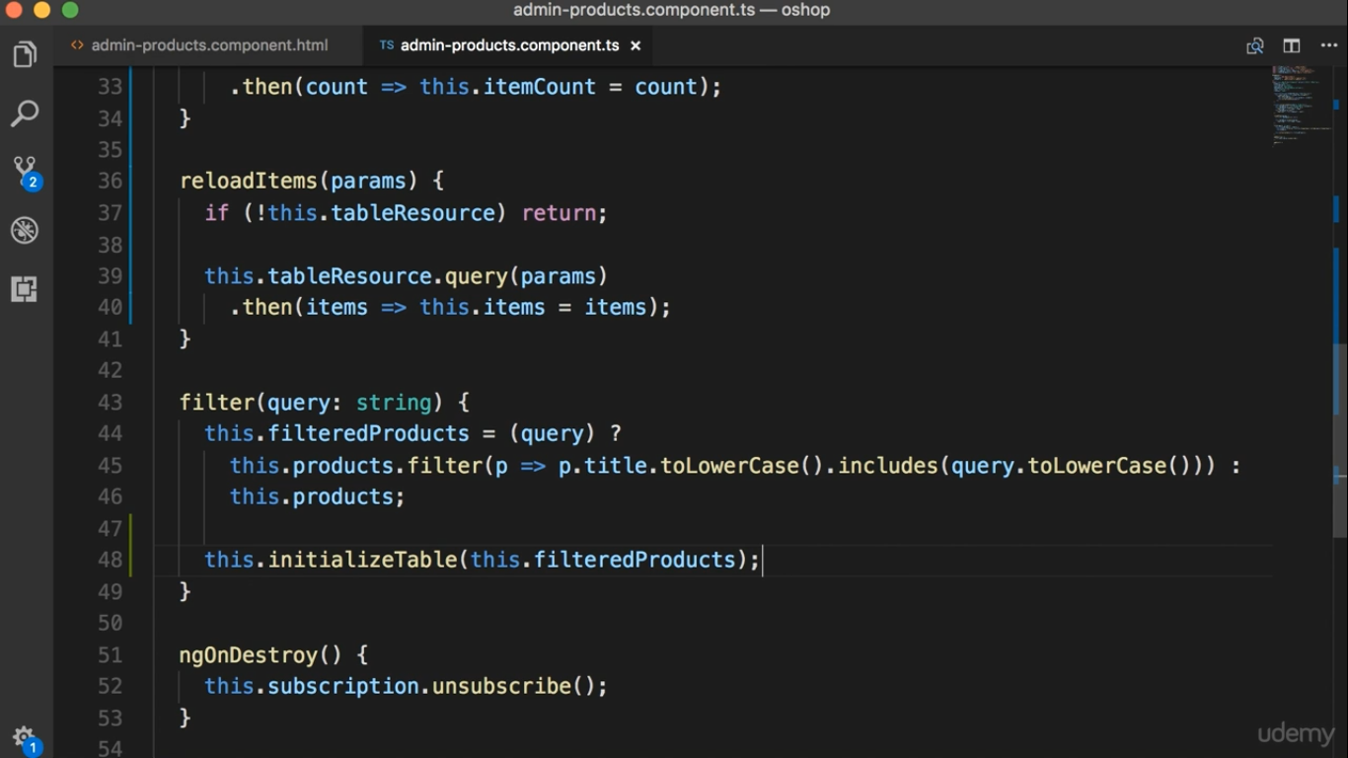

Slide 3
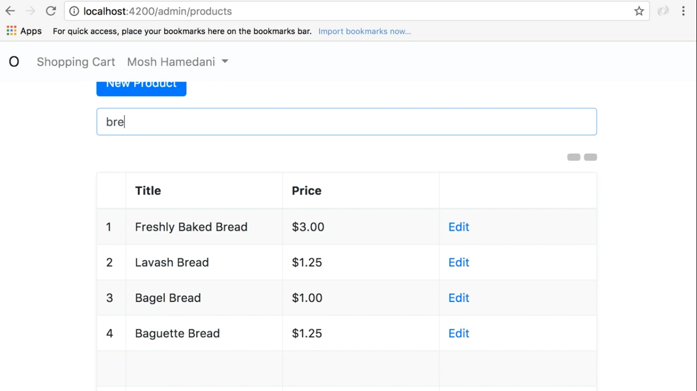

Slide 4
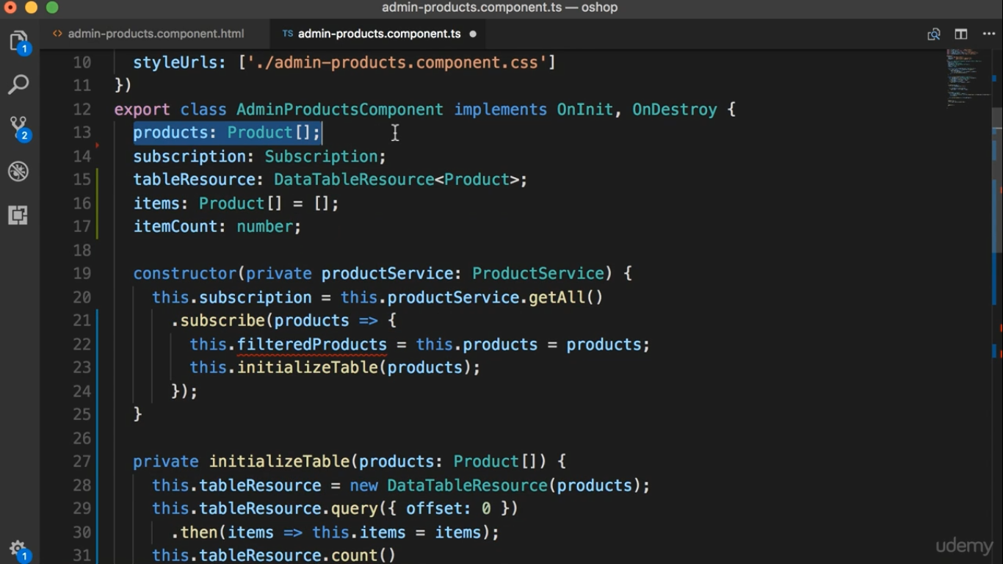
Complete list of Products get from the server
Delete the filteredProducts field

Slide 5
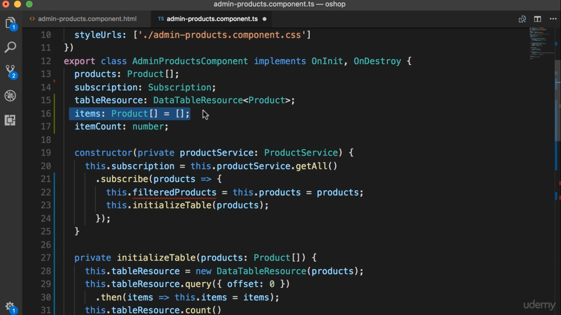
Only the products in the current page

Slide 6
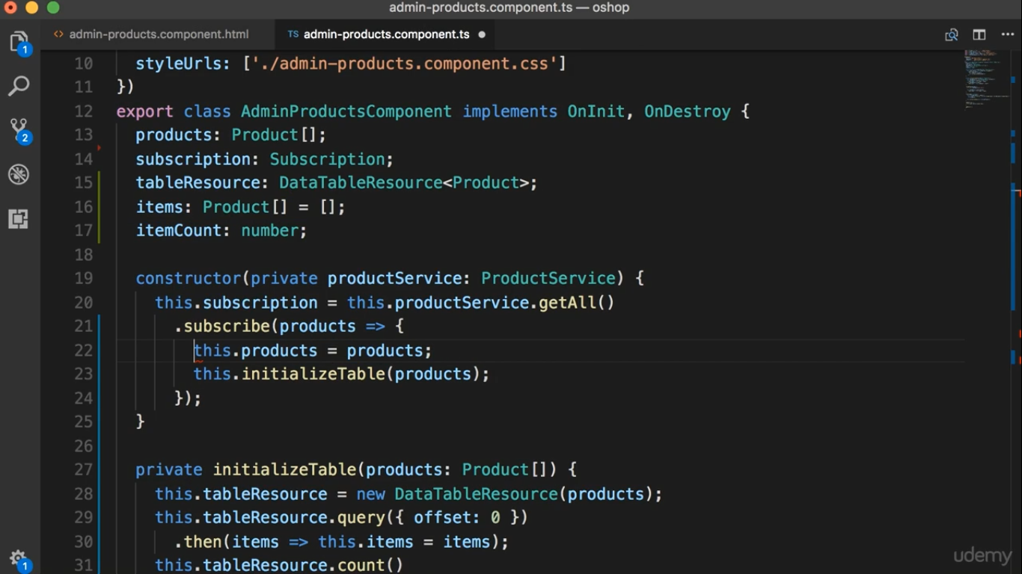

Slide 7
